Slide 1
Capstone project -credit card fraud-
-Ahinram mt

Slide 2
EDA
Post edc analysis, it is found that, fraud transaction happens at all cost.
When performed the scatterplot, the understanding of the data was not much helpful.
Skewness, helped in understanding that columns are normally distributed.

Slide 3
Model building & Hypertuning
Models used are : Logistic Regression, Decision Trees, Random Forest, XGBoost, Collective Strengths.

Slide 4
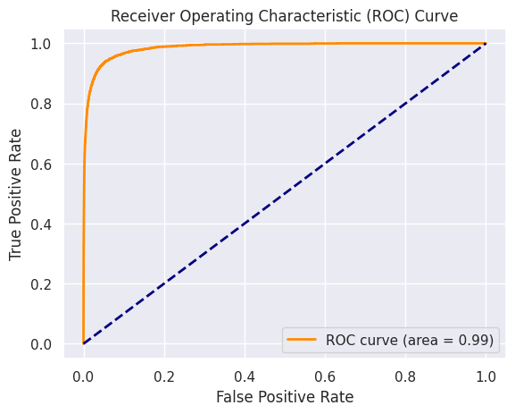
Best model & why?
Xgboost & adasyn model had the best sensitivity rate towards predicting the fraud.

Slide 5
Findings from the data
Average number of transactions per month are: 77183
Average number of fraudulent transactions per month are: 402
Average amount per fraudulent transactions is: 530.0

Slide 6
Compare the cost incurred per month by the bank before and after the model deployment
Cost incurred per month before the model was deployed = 213060.0
In a dataset of 402 transactions, a predictive model foresees that 95% will be identified as fraudulent, totalling around 382 transactions with a cost of $1.5 per transaction. However, 20 transactions are expected to be undetected, incurring a payment of $10,600 to customers. With a false positive rate of 0.054, an extra cost of $32.562 is imposed due to unnecessary payments. The total cost, considering customer payments and the added cost, amounts to $11,205.562. Despite these expenses, the model demonstrates substantial savings, with a final difference of USD $201,854.438 compared to the pre-model implementation scenario. This underscores the model's effectiveness in achieving considerable financial gains, emphasizing the nuanced trade-off between detection accuracy and associated costs.

